Slide 1
Lessons 1-36…
Place the following numbers on a number line:
-4, 3, 2, -1, 0
2) Simplify: $\left|−3\right|$
3) Name the property illustrated: (8 + 6) + 4 = 8 + (6 + 4)
4) What is the difference when the sum of 5 and 7 is subtracted from the product of 5 and 7?

Slide 2
Lessons 1-36…
5) Alberto went to the store with a twenty dollar bill. He bought a loaf of bread and a half-gallon of milk. The clerk gave him $15.17 in change. How much money did Alberto spend on bread and milk? Explain why your answer is reasonable.
6) The hike to the summit of Mt. Whitney began from the upper trailhead at 8365 ft. The elevation of Mt. Whitney’s summit is 14,496 ft. Write an equation that show how to find the elevation gain from the trailhead to the summit.

Slide 3
Lessons 1-36…
7) The total cost for five student tickets to the county fair was $28.75. How much did one ticket cost?
8) Cory sorted 375 quarters into groups of 40 so that he could put them in rolls. How many rolls can Cory fill with quarters?
9) There were 30 questions on the test. One third of the questions were true-false, and two fifths were multiple choice.
a) How many questions were true-false?
b) How many questions were multiple choice?

Slide 4
Lessons 1-36…
10) The 5000 meter run is an Olympic event. How many kilometers is 5000 meters?
11) James weighed 8 pounds 10 ounces at birth. How many ounces did James weigh?
12) In the four 8th grade classrooms there are 28, 29, 31, and 32 students. What is the average number of students in the 8th grade classrooms?

Slide 5
Lessons 1-36…
13) What is the median of the following numbers:
170, 191, 208, 15, 185, 175, 209, 187, 181, 195, 183, 219
14) A rectangular room is five yards long and four yards wide.
a) How much carpet is needed to cover the floor?
b) How many feet of baseboard are needed to reach around the room?

Slide 6
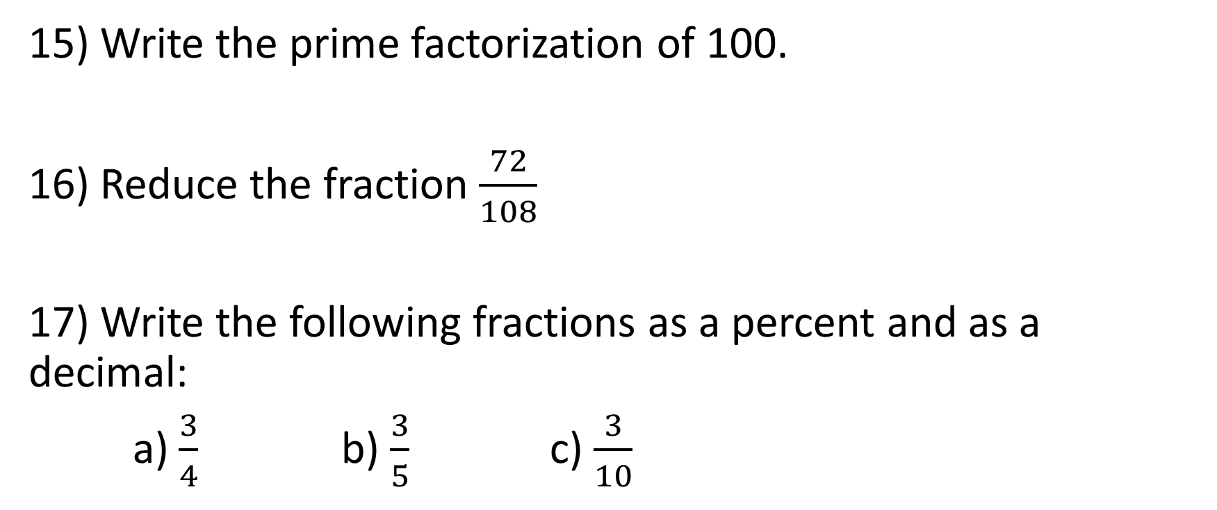
Lessons 1-36…
15) Write the prime factorization of 100.
16) Reduce the fraction $\frac{72}{108}$
17) Write the following fractions as a percent and as a decimal:
a) $\frac{3}{4}$ b) $\frac{3}{5}$ c) $\frac{3}{10}$

Slide 7
Lessons 1-36…
18) Express with exponents: 2xxyyyzzzz
19) Simplify: $\sqrt{196}$
20) Arrange the following numbers on a number line:
0, 1, $\sqrt{2}$, $\frac{3}{4}$, 0.5, -0.6

Slide 8
Lessons 1-36…
21) Round 3.14159 to two decimal places.
22) a) Draw 2 lines parallel to each other
b) Draw 2 lines perpendicular to each other
c) Draw a regular polygon with 6 sides
23) Find the area (A = $\frac{1}{2}$bh) of a triangle with a base of 8 in. and a height of 6 in.

Slide 9
Lessons 1-36…
24) Simplify: 20 – 2 · $3^{2}$ + (7 + 8) ÷ 5
25) What is the reciprocal of $\frac{5}{6}$ ?
26) A quart is $\frac{1}{4}$of a gallon. A pint is $\frac{1}{8}$ of a gallon. How many pints are in a quart? How many pints are in a gallon?

Slide 10
Lessons 1-36…
27) Simplify: a) 2$\frac{1}{3}$ x 1$\frac{1}{2}$
b) 1$\frac{2}{3}$ ÷ 2$\frac{1}{2}$
28) A carpenter is nailing horizontal boards to the outside surface of the building. The exposed portion of each board is 6$\frac{3}{4}$in. How many rows of boards are needed to reach to the top of an 8 ft. wall?

Slide 11
Lessons 1-36…
29) Jorge’s temperature was 100.2°F. The thermometer marked 98.6°F as normal body temperature. How many degrees above normal was Jorge’s temperature?
30) Chloe drove her car 236.4 miles on 9.6 gallons of gas. Find the number of miles per gallon the car averaged to the nearest mile per gallon.

Slide 12
Lessons 1-36…
31) Simplify: a) $x^{2}$ · $x^{4}$ b) $\frac{x^{5}}{x^{2}}$ c)${(x^{5})}^{3}$
32) A 30 ft. tall tree cast a shadow 18 ft. long. What was the ratio of height of the tree to the length of its shadow?
33) Find $\frac{5}{6}$ of $12.47.

Slide 13
Lessons 1-36…
34) At 6:00 a.m. the temperature was -12°C. By noon the temperature increased 8 degrees. Write an equation for this situation and find the temperature at noon.
35) The hikers started on the desert floor, 182 feet below sea level. After an hour of hiking they had climbed 1,018 ft. Write an equation for the situation and find the hiker’s elevation after an hour of hiking.

Slide 14
Lessons 1-36…
36) Nathan flips a coin three times. Find the probability of not getting heads at least once.
37) Emily is a softball player who has 21 hits in 60 at-bats. Express the probability that Emily will get a hit her next at-bat as a decimal number with three decimal places

Slide 15
Lessons 1-36…
38) Jocelyn has a checking balance of $1286. In the mail she receives a rebate check for $25 and a utility bill for $128. She deposits the rebate and writes a check for the bill. Write an equation with integers for the situation and find her checking balance after the transactions.

